Slide 1

Cross-platform reversing with Frida
Ole André Vadla Ravnås

Slide 2

Cross-platform reversing with Frida
Motivation
Existing tools often not a good fit for the task at hand
Creating a new tool usually takes too much effort
Short feedback loop: reversing is an iterative process
Use one toolkit for multi-platform instrumentation
Future remake of oSpy

Slide 3
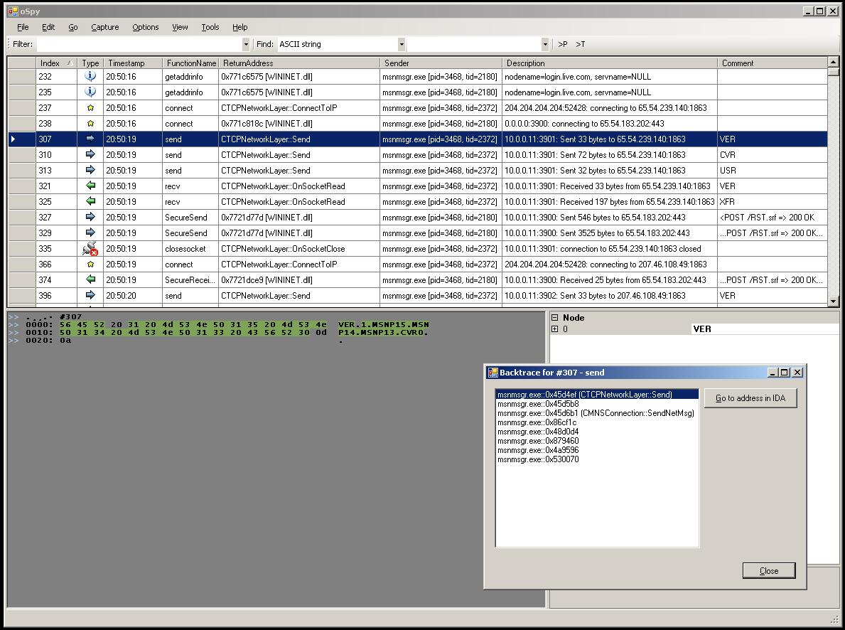
Cross-platform reversing with Frida
oSpy

Slide 4
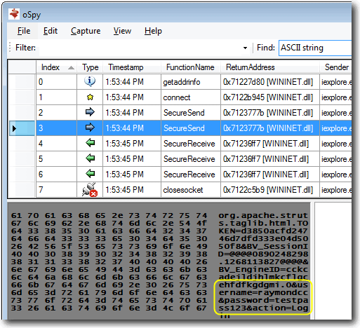
Cross-platform reversing with Frida
oSpy

Slide 5
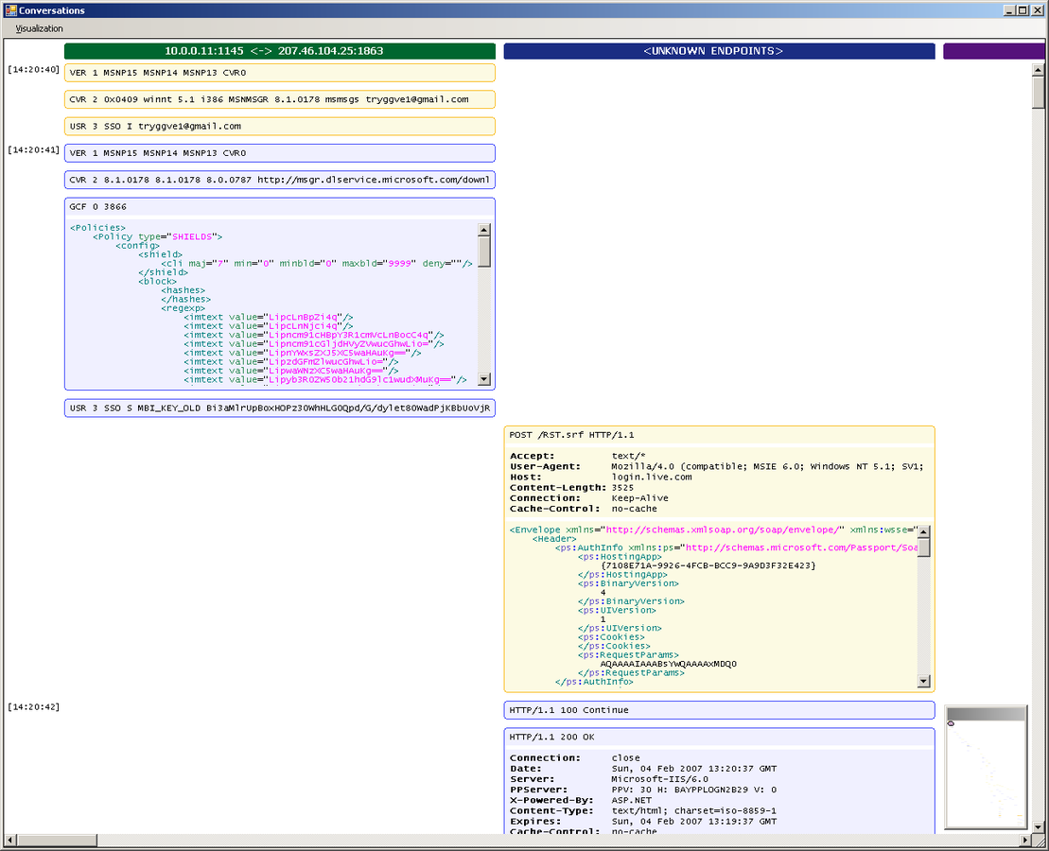
Cross-platform reversing with Frida
oSpy

Slide 6
Cross-platform reversing with Frida
What is Frida?
Dynamic instrumentation toolkit
Debug live processes
Scriptable
Execute your own debug scripts inside another process
Multi-platform
Windows, Mac, Linux, iOS, Android, QNX
Open Source

Slide 7
Cross-platform reversing with Frida
Let's explore the basics
1) Build and run the test app that we will instrument:
#include <stdio.h>
#include <unistd.h>
Void
f (int n)
{
printf ("Number: %d\n", n);
}
Int
main ()
{
int i = 0;
printf ("f() is at %p\n", f);
while (1)
{
f (i++);
sleep (1);
}
}
$ clang hello.c -o hello
$ ./hello
f() is at 0x106a81ec0
Number: 0
Number: 1
Number: 2
…
2) Make note of the
address of f(), which is
0x106a81ec0 here.

Slide 8
Cross-platform reversing with Frida
Basics 1/7: Hooking f() from Node.js
'use strict’;
const co = require('co');
const frida = require('frida');
const load = require('frida-load');
let session, script;
co(function *() {
session = yield frida.attach('hello');
const source = yield load(require.resolve('./agent.js'));
script = yield session.createScript(source);
script.events.listen('message', message => {
console.log(message);
});
yield script.load();
});
$ # install Node.js 5.1
$ npm install co frida frida-load
$ node app.js
{ type: 'send', payload: 531 }
{ type: 'send', payload: 532 }
…
'use strict’;
Interceptor.attach(ptr('0x106a81ec0'), {
onEnter(args) {
send(args[0].toInt32());
}
});
Address of f() goes here

Slide 9
Cross-platform reversing with Frida
Basics 1/7: Hooking f() from Python
import frida
import sys
session = frida.attach(“hello”)
script = session.create_script(”””
Interceptor.attach(ptr("0x106a81ec0"), {
onEnter(args) {
send(args[0].toInt32());
}
});
”””)
def on_message(message, data):
print(message)
script.on('message', on_message)
script.load()
sys.stdin.read()
Address of f() goes here
$ pip install frida
$ python app.py
{'type': 'send', 'payload': 531} {'type': 'send', 'payload': 532}
…
Notes:
There are also language-bindings for QML, .NET, etc. The API is the same except for local conventions like create_script() vs createScript().
We will stick to the Node.js bindings for the remainder of this workshop.

Slide 10
Cross-platform reversing with Frida
Basics 2/7: Modifying function arguments
'use strict’;
const co = require('co');
const frida = require('frida');
const load = require('frida-load');
let session, script;
co(function *() {
session = yield frida.attach('hello’);
const source = yield load(require.resolve('./agent.js'));
script = yield session.createScript(source);
yield script.load();
});
$ node app.js
Number: 1281
Number: 1282
Number: 1337
Number: 1337
Number: 1337
Number: 1337
Number: 1296
Number: 1297
Number: 1298
…
Once we stop it
the target is back to
normal
'use strict’;
Interceptor.attach(ptr('0x106a81ec0'), {
onEnter(args) {
args[0] = ptr("1337");
}
});
Address of f() goes here

Slide 11
Cross-platform reversing with Frida
Basics 3/7: Calling functions
'use strict’;
const co = require('co');
const frida = require('frida');
const load = require('frida-load');
let session, script;
co(function *() {
session = yield frida.attach('hello’);
const source = yield load(require.resolve('./agent.js'));
script = yield session.createScript(source);
yield script.load();
yield session.detach();
});
$ node app.js
Number: 1281
Number: 1282
Number: 1911
Number: 1911
Number: 1911
Number: 1283
Number: 1284
Number: 1285
…
'use strict’;
const f = new NativeFunction(
ptr(’0x10131fec0’), ‘void’, ['int']);
f(1911);
f(1911);
f(1911);
Address of f() goes here

Slide 12
Cross-platform reversing with Frida
Basics 4/7: Sending messages
'use strict’;
const co = require('co');
const frida = require('frida');
const load = require('frida-load');
let session, script;
co(function *() {
session = yield frida.attach('hello');
const source = yield load(require.resolve('./agent.js'));
script = yield session.createScript(source);
script.events.listen('message', message => {
console.log(message);
});
yield script.load();
});
$ node app.js
{ type: 'send’,
payload: { user: { name: 'john.doe' }, key: '1234' } }
{ type: 'error’,
description: 'ReferenceError: oops is not defined’,
stack: 'ReferenceError: oops is not defined\n at Object.1 (agent.js:10:1)\n at s (../../node_modules/browser-pack/_prelude.js:1:1)\n at e (../../node_modules/browser-pack/_prelude.js:1:1)\n at ../../node_modules/browser-pack/_prelude.js:1:1’,
fileName: 'agent.js’,
lineNumber: 10,
columnNumber: 1
}
'use strict’;
send({
user: {
name: 'john.doe’
},
key: '1234’
});
oops;

Slide 13
Cross-platform reversing with Frida
Basics 5/7: Receiving messages
'use strict’;
const co = require('co');
const frida = require('frida');
const load = require('frida-load');
let session, script;
co(function *() {
session = yield frida.attach('hello');
const source = yield load(require.resolve('./agent.js'));
script = yield session.createScript(source);
script.events.listen('message', message => {
console.log(message);
});
yield script.load();
yield script.postMessage({ magic: 21 });
yield script.postMessage({ magic: 12 });
});
$ node app.js
{ type: 'send', payload: 42 }
{ type: 'send', payload: 36 }
'use strict’;
let i = 2;
function handleMessage(message) {
send(message.magic * i);
i++;
recv(handleMessage);
}
recv(handleMessage);

Slide 14
Cross-platform reversing with Frida
Basics 6/7: Blocking receives
'use strict’;
const co = require('co');
const frida = require('frida');
const load = require('frida-load');
let session, script;
co(function *() {
session = yield frida.attach('hello');
const source = yield load(require.resolve('./agent.js'));
script = yield session.createScript(source);
script.events.listen('message', message => {
const number = message.payload.number;
script.postMessage({ number: number * 2 });
});
yield script.load();
});
$ node app.js
Number: 2183
Number: 2184
Number: 4370
Number: 4372
Number: 4374
Number: 4376
Number: 4378
Number: 2190
Number: 2191
Number: 2192
…
Once we stop it
the target is back to
normal
'use strict’;
Interceptor.attach(ptr('0x106a81ec0'), {
onEnter(args) {
send({ number: args[0].toInt32() });
const op = recv(reply => {
args[0] = ptr(reply.number);
});
op.wait();
}
});
Address of f() goes here

Slide 15
Cross-platform reversing with Frida
Basics 7/7: RPC
'use strict’;
const co = require('co');
const frida = require('frida');
const load = require('frida-load');
let session, script;
co(function *() {
session = yield frida.attach('hello');
const source = yield load(require.resolve('./agent.js'));
script = yield session.createScript(source);
yield script.load();
const api = yield script.getExports();
const result = yield api.disassemble('0x106a81ec0');
console.log(result);
yield session.detach();
});
$ node app.js
push rbp
$
Address of f() goes here
'use strict’;
rpc.exports = {
disassemble(address) {
return Instruction.parse(ptr(address)).toString();
}
};

Slide 16
Cross-platform reversing with Frida
Launch and spy on iOS app
'use strict’;
const co = require('co');
const frida = require('frida');
const load = require('frida-load');
let session, script;
co(function *() {
const device = yield frida.getUsbDevice();
const pid = yield device.spawn(['com.apple.AppStore']);
session = yield device.attach(pid);
const source = yield load( require.resolve('./agent.js'));
script = yield session.createScript(source);
script.events.listen('message', message => {
if (message.type === 'send' && message.payload.event === 'ready’)
device.resume(pid);
else
console.log(message);
});
yield script.load();
})
.catch(console.error);
$ node app.js
{ type: 'send', payload: { event: 'call', name: 'CC_MD5' } }
{ type: 'send', payload: { event: 'call', name: 'CCDigest' } }
{ type: 'send', payload: { event: 'call', name: 'CNEncode' } }
…
'use strict';
Module.enumerateExports('libcommonCrypto.dylib', {
onMatch(e) {
if (e.type === 'function') {
try {
Interceptor.attach(e.address, {
onEnter(args) {
send({ event: 'call', name: e.name });
}
});
} catch (error) {
console.log('Ignoring ' + e.name + ': ' + error.message);
}
}
},
onComplete() {
send({ event: 'ready' });
}
});

Slide 17
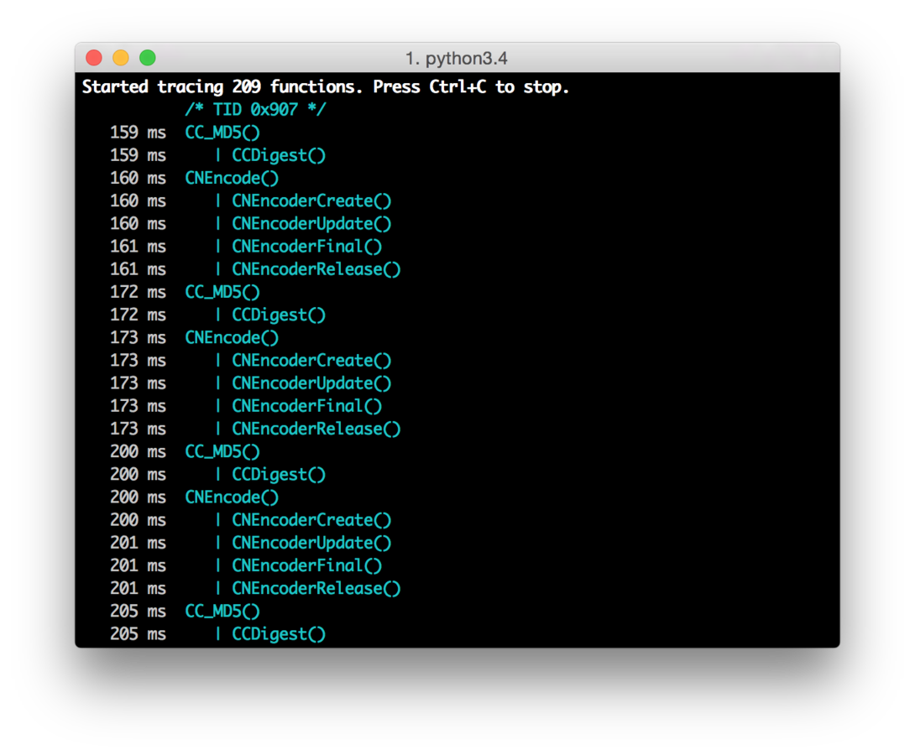
Cross-platform reversing with Frida
But there’s an app for that
$ sudo easy_install frida
$ frida-trace -U -f com.apple.AppStore -I libcommonCrypto.dylib
Notes:
Show that auto-generated .js can be live-edited.

Slide 18
Cross-platform reversing with Frida
Dump iOS UI
'use strict’;
const co = require('co');
const frida = require('frida');
const load = require('frida-load');
let session, script;
co(function *() {
const device = yield frida.getUsbDevice();
const app = yield device.getFrontmostApplication();
if (app === null)
throw new Error("No app in foreground");
session = yield device.attach(app.pid);
const source = yield load(require.resolve('./agent.js'));
script = yield session.createScript(source);
script.events.listen('message', message => {
console.log(message.payload.ui);
session.detach();
});
yield script.load();
});
$ node --harmony dump-ui.js
<UIWindow: 0x15fe3ca40; frame = (0 0; 375 667); autoresize = W+H; gestureRecognizers = <NSArray: 0x17424c1e0>; layer = <UIWindowLayer: 0x17023dcc0>>
| <UIView: 0x15fd2dbd0; frame = (0 0; 375 667); autoresize = W+H; layer = <CALayer: 0x174432320>>
| | <UIView: 0x15fe64250; frame = (0 0; 375 667); autoresize = W+H; layer = <CALayer: 0x170235340>>
| | | <UIView: 0x15fd506e0; frame = (0 0; 375 667);
…
'use strict’;
ObjC.schedule(ObjC.mainQueue, () => {
const window = ObjC.classes.UIWindow.keyWindow();
const ui = window.recursiveDescription().toString();
send({ ui: ui });
});

Slide 19
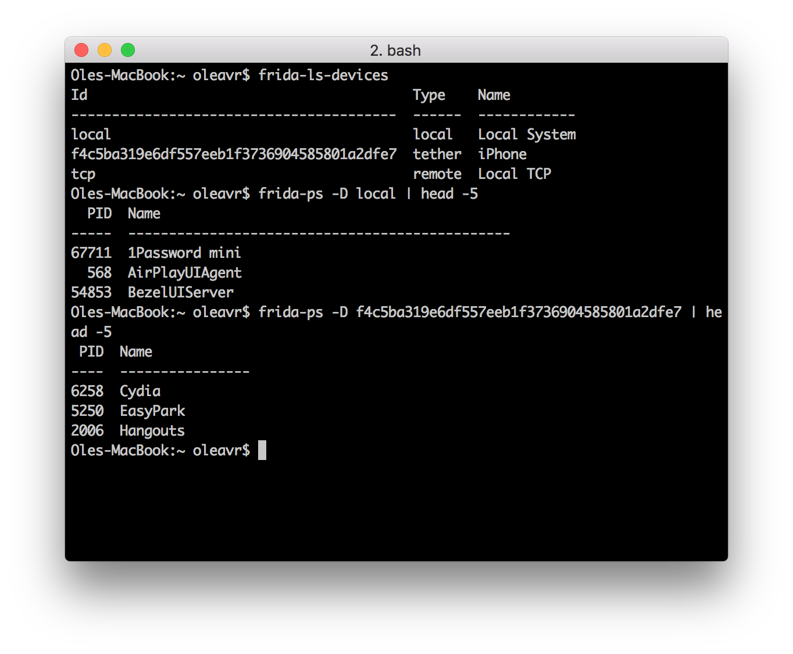
Cross-platform reversing with Frida
Hold on a sec, what if I have many phones connected?
Notes:
Show that auto-generated .js can be live-edited.

Slide 20
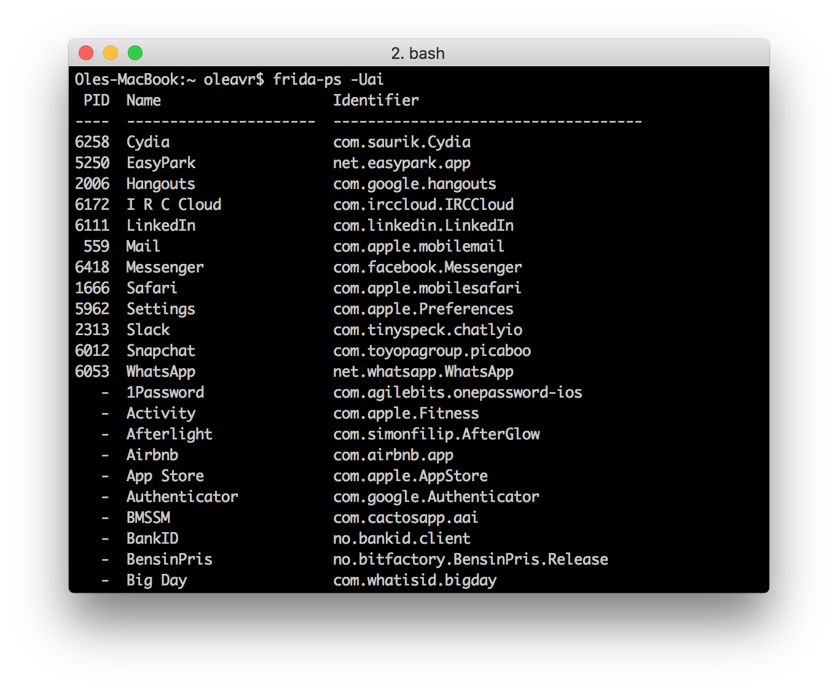
Cross-platform reversing with Frida
Which apps are installed?
Notes:
Show that auto-generated .js can be live-edited.

Slide 21
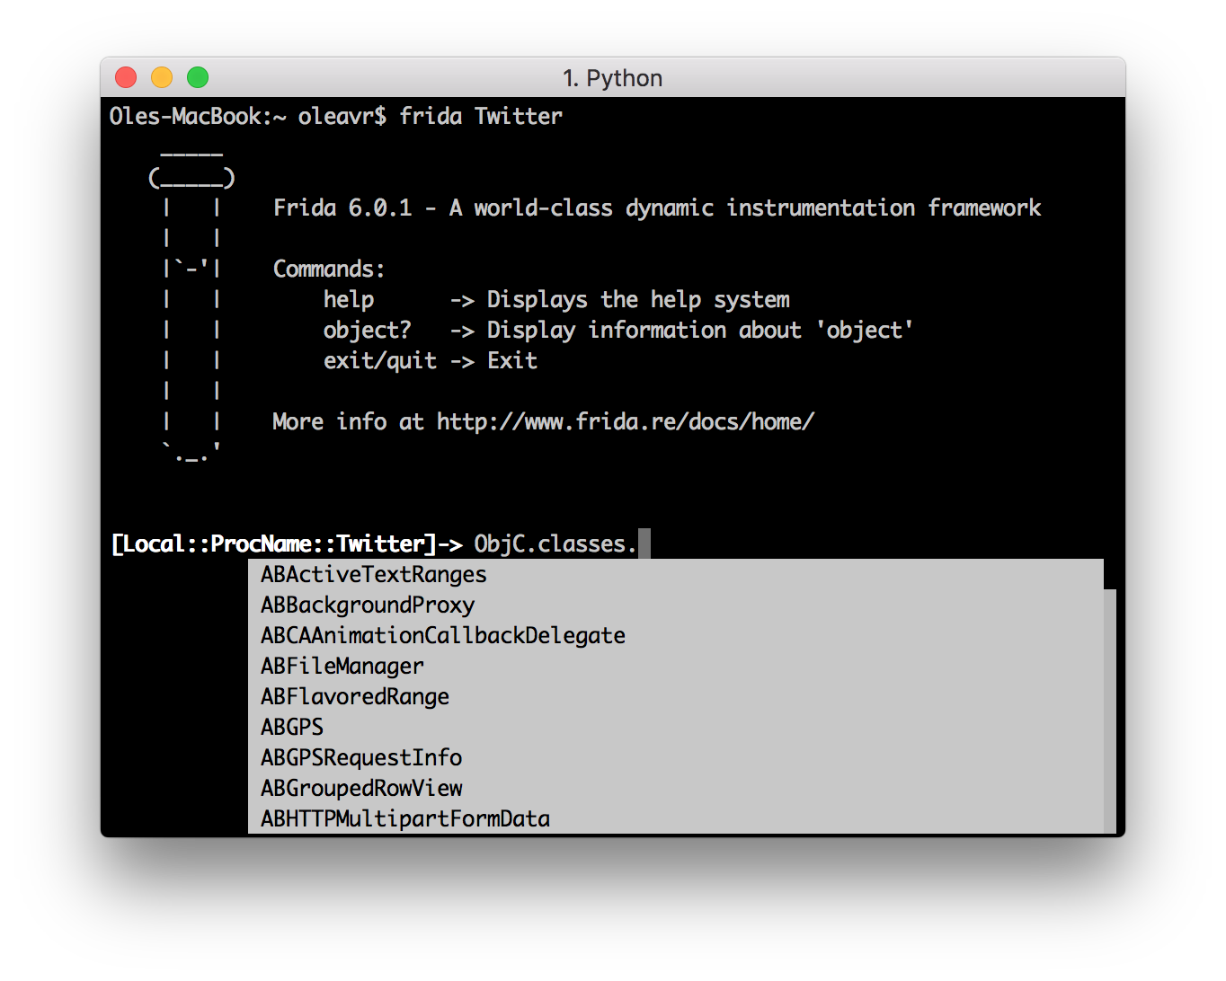
Cross-platform reversing with Frida
Speaking of apps, we also have a REPL:

Slide 22
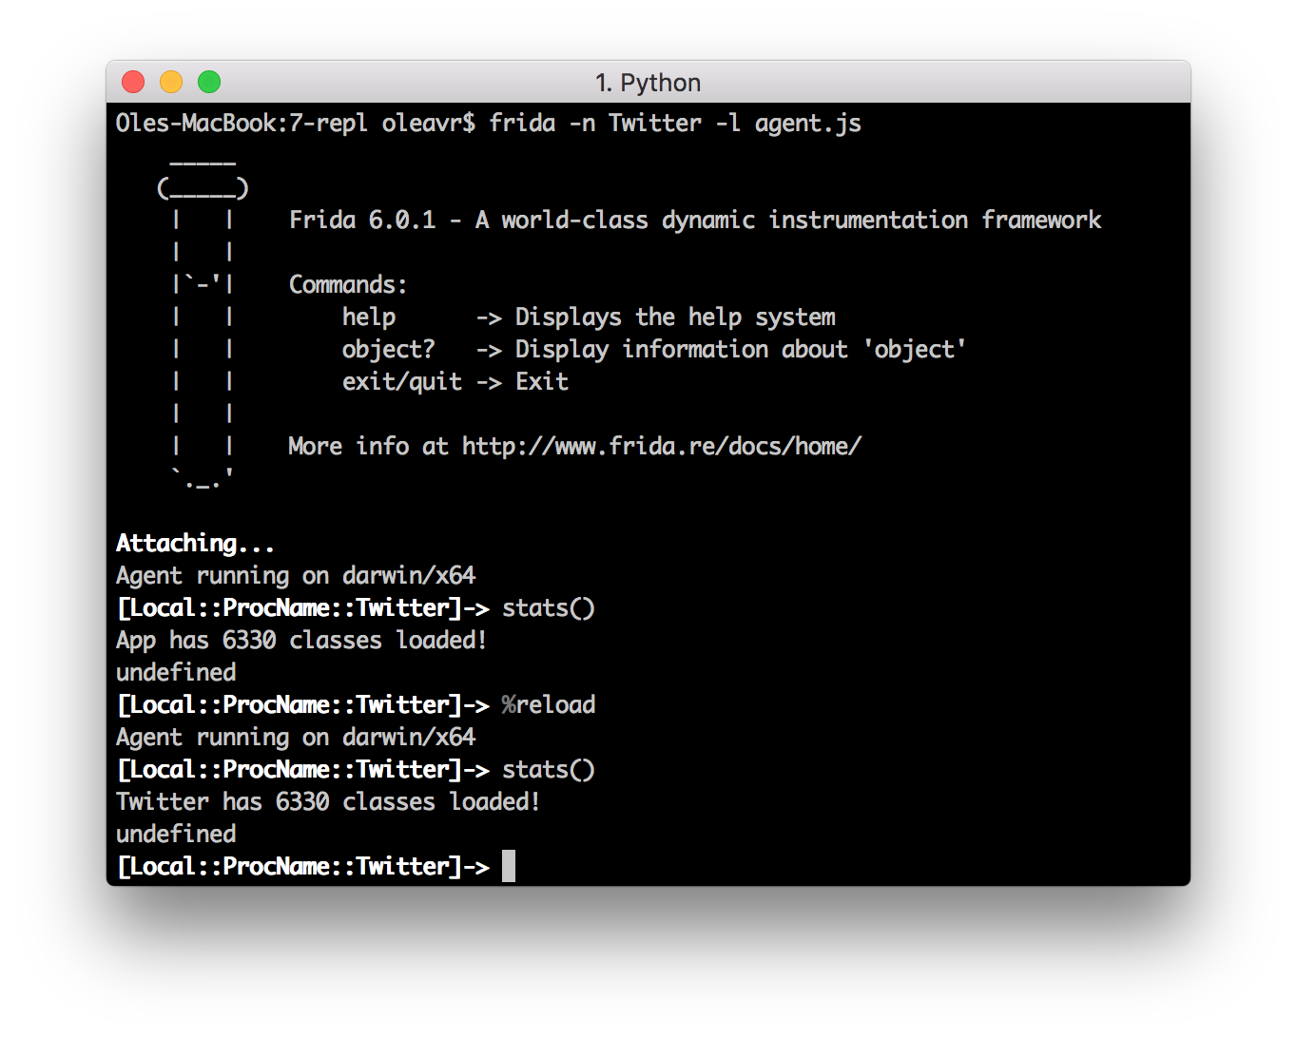
Cross-platform reversing with Frida
The REPL is your best friend for prototyping scripts

Slide 23
Cross-platform reversing with Frida
Uninstall iOS app
'use strict’;
const LSApplicationWorkspace = ObjC.classes.LSApplicationWorkspace;
const onProgress = new ObjC.Block({
retType: 'void’,
argTypes: ['object'],
implementation: (progress) => {
console.log('onProgress: ' + progress);
}
});
function uninstall(appId) {
const workspace = LSApplicationWorkspace.defaultWorkspace();
return workspace.uninstallApplication_withOptions_usingBlock_(appId, null, onProgress);
}
$ frida –U SpringBoard –l agent.js

Slide 24
Cross-platform reversing with Frida
Interacting with Objective-C
ObjC.available – is the runtime present?
new ObjC.Object(ptr(‘0x1234’)) – interact with object at 0x1234
ObjC.classes – all loaded classes
Object.keys(ObjC.classes) to list all names
if (‘UIView’ in ObjC.classes) to check for class presence
ObjC.protocols – all loaded protocols
[NSURL URLWithString:foo relativeToURL:bar] translates to ObjC.classes.NSURL.URLWithString_relativeToURL_(foo, bar)
NSURL[‘- setResourceValues:error:’] to access instance methods from its class
Assign to .implementation to replace a method
ObjC.choose() – scan heap looking for Objective-C instances

Slide 25
Cross-platform reversing with Frida
Hooking Objective-C methods
The swizzling way:
const method = ObjC.classes.AVAudioSession['- setCategory:error:'];
const originalImpl = method.implementation;
method.implementation = ObjC.implement(method, function (self, sel, category, error) {
return originalImpl(self, self, category, error);
});
The low-level way:
const method = ObjC.classes.AVAudioSession['- setCategory:error:'];
Interceptor.attach(method.implementation, {
onEnter(args) {
},
onLeave(retval) {
}
});

Slide 26
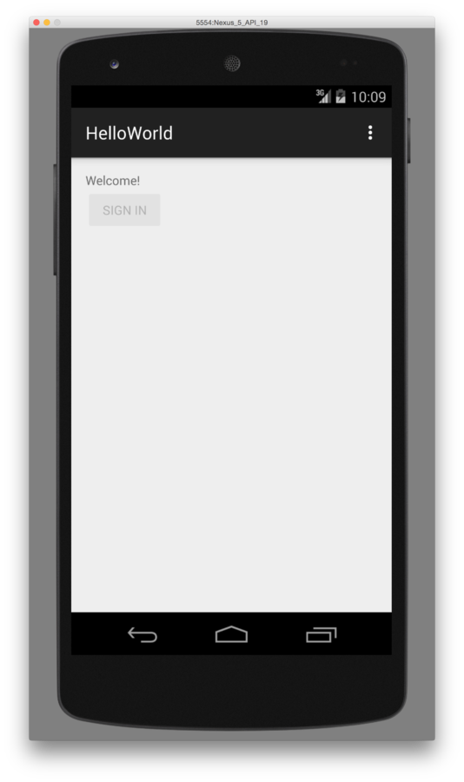
Cross-platform reversing with Frida
Android instrumentation
'use strict’;
const co = require('co');
const frida = require('frida');
const load = require('frida-load');
let session, script;
co(function *() {
const device = yield frida.getUsbDevice();
session = yield device.attach('re.frida.helloworld');
const source = yield load(require.resolve('./agent.js'));
script = yield session.createScript(source);
script.events.listen('message', message => {
console.log(message);
});
yield script.load();
});
'use strict’;
Dalvik.perform(() => {
const MainActivity = Dalvik.use(
're.frida.helloworld.MainActivity');
MainActivity.isRegistered.implementation = () => {
console.log('isRegistered() w00t');
return true;
};
});

Slide 27
Cross-platform reversing with Frida
Interacting with Java
Java.available – is the runtime present?
Java.perform(fn) – interact with the Java VM from the given callback
Java.cast(ptr(‘0x1234’), Java.use(“android.os.Handler”)) – interact with object at 0x1234
Constructors are exposed as $new(), and overloads can be selected as with any methods:
Handler.$new.overload("android.os.Looper").call(Handler, looper)
Java.enumerateLoadedClasses() – all loaded classes
Assign to .implementation to replace a method
Java.choose() – scan heap looking for Java instances

Slide 28
Cross-platform reversing with Frida
Hooking Java methods
const Handler = classFactory.use("android.os.Handler");
Handler.dispatchMessage.implementation = function (msg) {
// Chain up to the original implementation
this.dispatchMessage(msg);
};
Notes:
Optimized for Dalvik on Android 4.4. ART support for hooking is not yet ready.

Slide 29
Cross-platform reversing with Frida
Early instrumentation
pid = frida.spawn([“/bin/ls”])
session = frida.attach(pid)
script = session.create_script(“your script”)
<apply instrumentation> – recommend RPC for this: script.exports.init()
frida.resume(pid) – application’s main thread will enter main()
For mobile apps specify its identifier: spawn([“com.apple.AppStore”])
Forgot what it was? Use frida-ps -ai

Slide 30
Cross-platform reversing with Frida
How about implicitly spawned processes? Enter spawn gating!
device.on(‘spawned’, on_spawned)
device.enable_spawn_gating()
device.enumerate_pending_spawns()
Examples:
https://gist.github.com/oleavr/ae7bcbbb9179852a4731
Only implemented for iOS and Android.

Slide 31
Cross-platform reversing with Frida
Backtraces
'use strict’;
Interceptor.attach(Module.findExportByName('libSystem.B.dylib', 'connect'), {
onEnter() {
console.log('connect called from:\n\t' +
Thread.backtrace(this.context, Backtracer.ACCURATE).join('\n\t'));
}
});
$ frida –n Spotify -l agent.js
[Local::PID::66872]-> connect called from: 0x106de3a36 0x106de6851 0x10753d092 0x10753ecd1
Notes:
Optimized for Dalvik on Android 4.4. ART support for hooking is not yet ready.

Slide 32
Cross-platform reversing with Frida
Backtraces with debug symbols
'use strict’;
Interceptor.attach(Module.findExportByName('libSystem.B.dylib', 'connect'), {
onEnter() {
console.log('connect called from:\n\t' +
Thread.backtrace(this.context, Backtracer.ACCURATE)
.map(DebugSymbol.fromAddress)
.join('\n\t'));
}
});
$ frida –n Spotify -l agent.js
[Local::ProcName::Twitter]-> connect called from:
0x7fff9b5dd6b1 libsystem_network.dylib!get_host_counts
0x7fff9b60ee4f libsystem_network.dylib!tcp_connection_destination_create
0x7fff9b5e2eb7 libsystem_network.dylib!tcp_connection_destination_add
0x7fff9b5e2e5a libsystem_network.dylib!__tcp_connection_start_host_block_invoke
0x7fff9b6079a5 libsystem_network.dylib!tcp_connection_host_resolve_result
0x7fff9ece7fe0 libsystem_dnssd.dylib!handle_addrinfo_response
Notes:
Optimized for Dalvik on Android 4.4. ART support for hooking is not yet ready.

Slide 33
Cross-platform reversing with Frida
Best practices
Use Node.js bindings to frida-load your agent.js so you can:
Split your script into multiple files
Use Frida modules from the community
Reuse thousands of modules from npm
Use ES6 features to write modern JavaScript – Frida support it
REPL is great for prototyping with -l and %reload

Slide 34
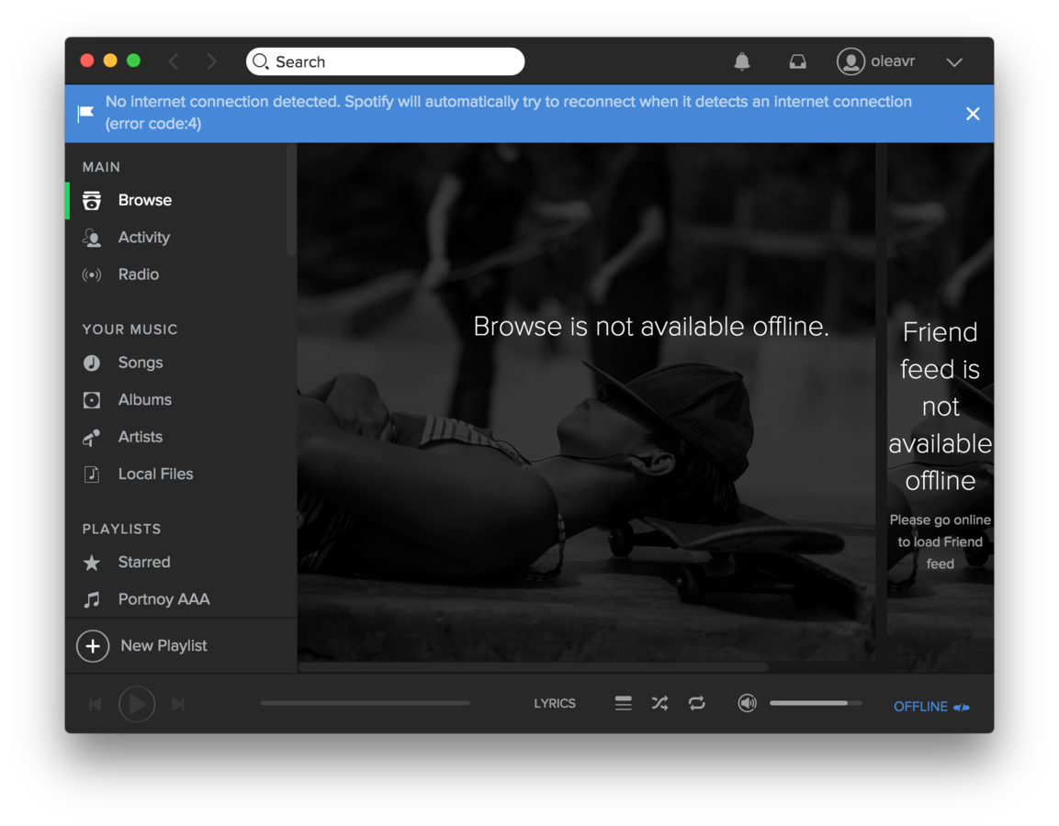
Cross-platform reversing with Frida
Injecting errors
'use strict’;
const co = require('co');
const frida = require('frida');
const load = require('frida-load');
let session, script;
co(function *() {
session = yield frida.attach(process.argv[2]);
const source = yield load(require.resolve('./agent.js'));
script = yield session.createScript(source);
script.events.listen('message', message => {
console.log(message);
});
yield script.load();
})
.catch(console.error);
$ node app.js Spotify
connect() family=2 ip=78.31.9.101 port=80 blocking!
connect() family=2 ip=193.182.7.242 port=80 blocking! connect() family=2 ip=194.132.162.4 port=443 blocking! connect() family=2 ip=194.132.162.4 port=80 blocking! connect() family=2 ip=194.132.162.212 port=80 blocking! connect() family=2 ip=194.132.162.196 port=4070 blocking! connect() family=2 ip=193.182.7.226 port=443 blocking!
Interceptor.replace(connect,
new NativeCallback((socket, address, addressLen) => {
…
if (port === 80 || port === 443 || port === 4070) {
this.errno = ECONNREFUSED;
return -1;
} else {
return connect(socket, address, addressLen);
}
});

Slide 35
Cross-platform reversing with Frida
All calls between two recv() calls
'use strict’;
const co = require('co');
const frida = require('frida');
const load = require('frida-load');
co(function *() {
…
yield script.load();
});
$ node app.js Spotify
connect() family=2 ip=78.31.9.101 port=80 blocking! connect() family=2 ip=193.182.7.242 port=80 blocking! connect() family=2 ip=194.132.162.4 port=443 blocking! connect() family=2 ip=194.132.162.4 port=80 blocking! connect() family=2 ip=194.132.162.212 port=80 blocking! connect() family=2 ip=194.132.162.196 port=4070 blocking! connect() family=2 ip=193.182.7.226 port=443 blocking!
'use strict';
…
Stalker.follow({
events: {
call: true
},
onReceive(events) {
blobs.push(events);
if (state === COLLECTING) {
sendResult();
state = DONE;
}
}
});
…

Slide 36
Cross-platform reversing with Frida
Questions?
Twitter: @oleavr

Slide 37
Cross-platform reversing with Frida
Thanks!
Please drop by #frida on FreeNode, and don't forget to join our mailing list:
https://groups.google.com/d/forum/frida-dev

